Slide 1
It is illegal to reproduce any portion of this PowerPoint, whether digitally, printed or otherwise. This would be in strict violation of copyright law.
Please note that the purchase of the Joy of Parenthood PowerPoint Presentation is for the PowerPoint as it exists and is available as of the today’s date. It does not include any future materials, updates, or PowerPoints that CCI may produce on the same or similar topics.
Please note that the purchase of the Joy of Parenthood PowerPoint Presentation is for the PowerPoint as it exists and is available as of today’s date. It does not include any future materials, updates, or PowerPoints that CCI may produce on the same or similar topic.
©2012 Customized Communications, Inc.
Reviewed 3/2013

Slide 3
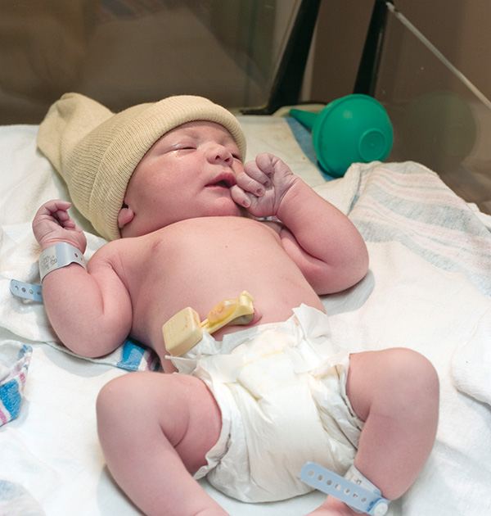
Newborn Appearance and Characteristics

Slide 4
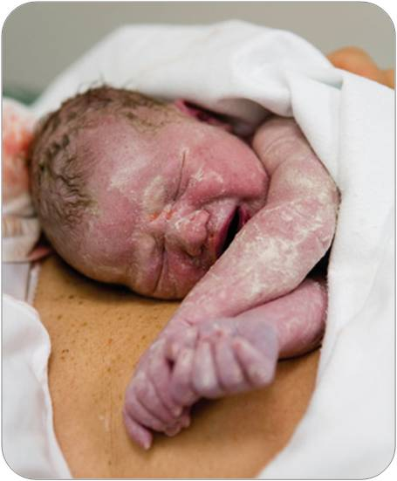
Initial Appearance
Vernix is the thick, white, creamy coating that protects the baby’s skin.
Newborns may be gray or purple until they take their first breath and start to cry. Hands and feet may remain blue when body is pink. This is called acrocyanosis.

Slide 5
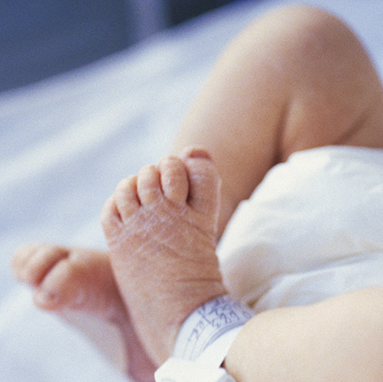
Dry Skin
The protective vernix will start to slough off around 38 weeks.
If your baby is born after this time frame he may have dry, flaky skin.
Notes:
No lotion needed/recommended until 6 months of age

Slide 6
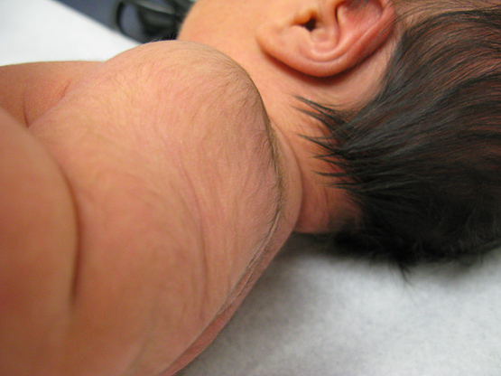
Lanugo
Lanugo is the fine hair some babies may be born with. Especially those who were born before their due date. Your baby will not grow up hairy! You’ll notice that in a couple of weeks it will start to slough off.

Slide 7
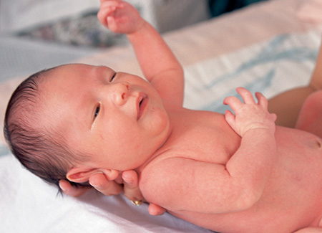
The Shape of Your Baby’s Head at Birth.
A newborn’s head may seem misshapen immediately after birth. This will change. The head will go back to a normal shape in a relatively short period of time.

Slide 8
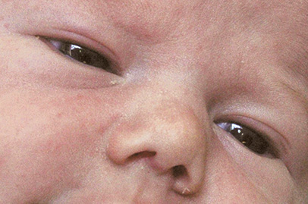
Milia
Milia are small, white, pimple like bumps
and are immature oil glands.

Slide 9
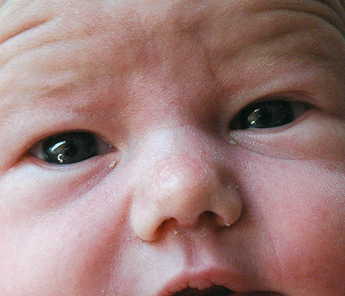
Eye facts:
Your baby’s eyes are typically gray-blue in color. May take 9 months to a year before true color is known.
Even though a baby cries, there are no tears and they may not be present for up to 3 months of age.
In the first few weeks after delivery, your baby’s eyes may appear crusty.
Red spots (broken blood vessels) may form in the whites of your baby’s eyes due to the birth process. They produce NO long-lasting effects to your baby’s sight.
Eyes

Slide 10
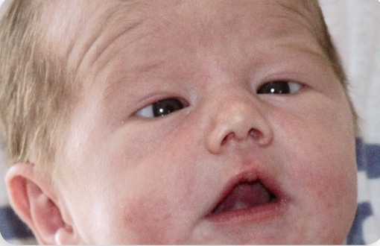
Crossed Eyes
The muscles in your baby’s eyes are not fully developed. Often a baby will appear to be cross-eyed and this can give new parents a scare.
Do not worry!
Over time, the muscles will develop properly.

Slide 11
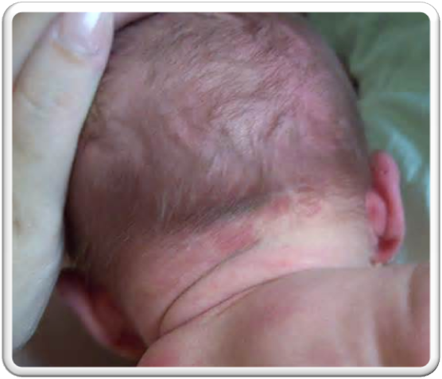
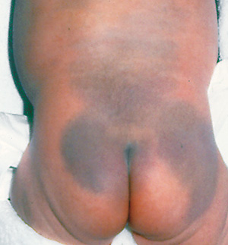
Birth Marks
Stork Bite
Slate Grey Spots
Notes:
Slate Grey Spots (AKA:Mongolian spots) are flat birthmarks commonly found on African-American, Asian, Hispanic and Native American babies. They usually will fade after the 1st year of life.

Slide 12
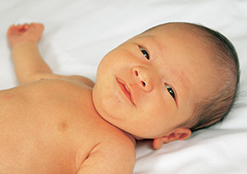
Jaundice
Jaundice is the yellow coloring of a baby’s skin and eyes due to bilirubin build-up.
Notes:
Newborn babies have additional red blood cells. When the extra blood cells are broken down, they create bilirubin. The biliruben is excreted through the urine urine and stool. When there is more biliruben that the body can excrete, a yellow color is seen in the skin and eyes. While jaundice is normal, the doctor will assess the amount of jaundice a baby has. High levels of biliruben can be dangerous and require treatment. Phototherapy via “bililights” or a “biliblanket” are used. The special light helps break down the biliruben so it is more easily excreted by the body.

Slide 13
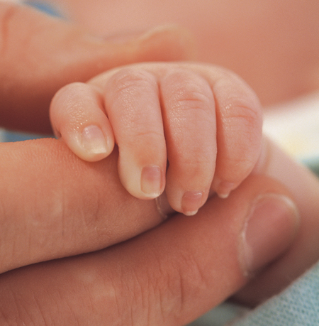
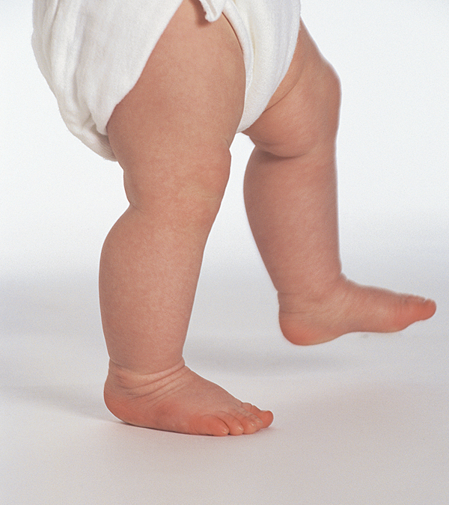
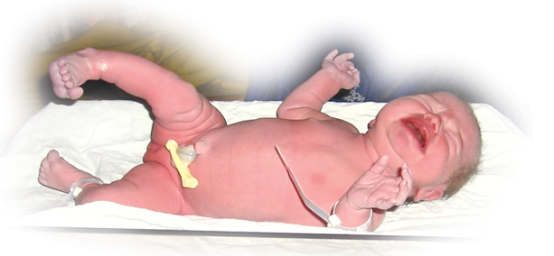
Reflexes present at birth

Slide 14
Moro Reflex
Notes:
Often called the “startle reflex”, this can be one of the scariest for new parents. This is a natural, healthy
response and will disappear over time.

Slide 15
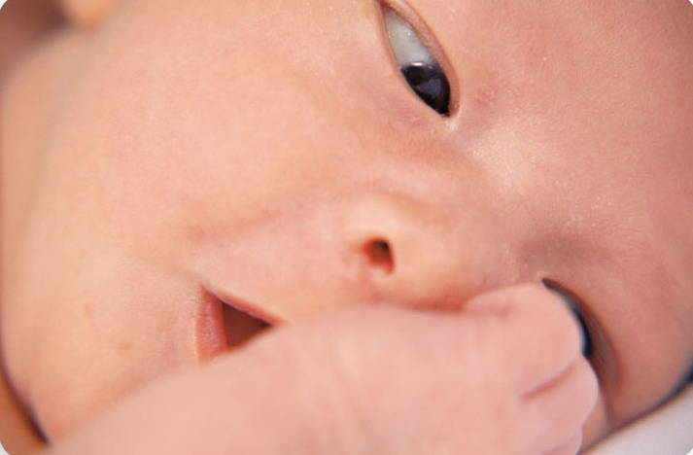
Rooting Reflex
Notes:
This response is a feeding cue. This cue helps the baby search for the breast or bottle so that he can eat.

Slide 16
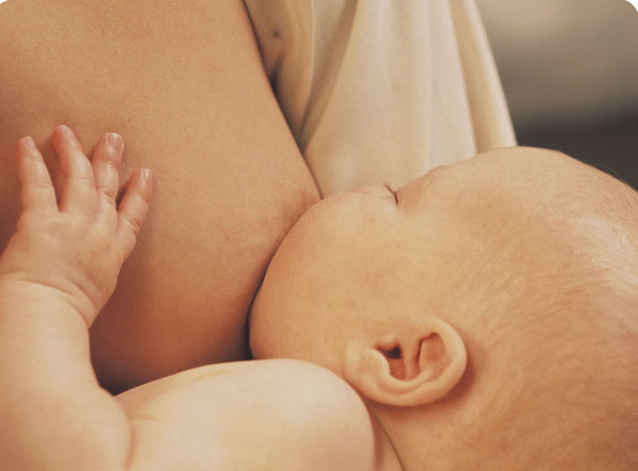
Sucking Reflex
Notes:
When the roof of the baby’s mouth is touched the “sucking reflex” begins.

Slide 17
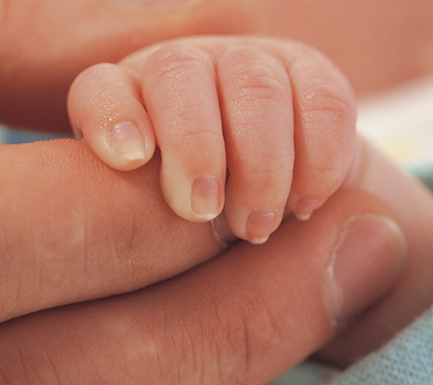
Grasp Reflex
Notes:
This reflex is a guard against falling and thought to enable the baby to hang on to his mother

Slide 18
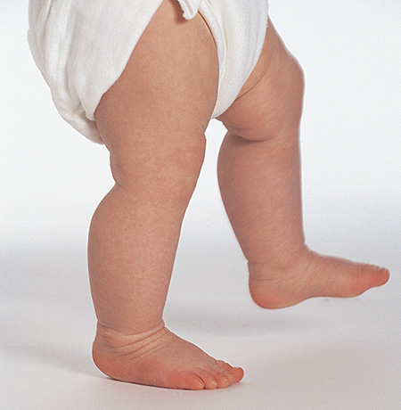
Step Reflex
Notes:
This reflex is present at birth, disappears and then comes back when your child is ready for those first real steps.

Slide 19
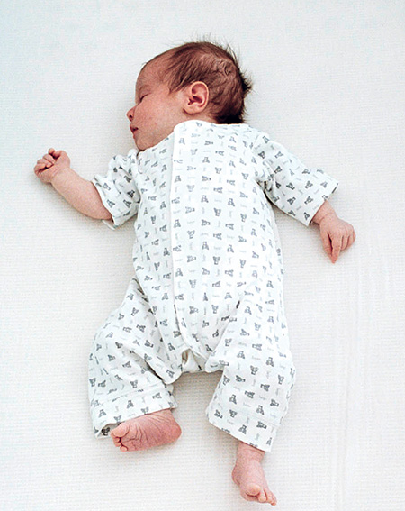
Tonic Reflex
Notes:
Often called the “fencing position”, this reflex occurs when you lie your baby on his back.

Slide 20
You will be amazed at the resilience of your new baby. The reflexes you will notice…
A YAWN
THE GRASP OF YOUR FINGER
A JERK
A WINCE
…are part of your baby’s
built-in survival responses at birth.

Slide 21
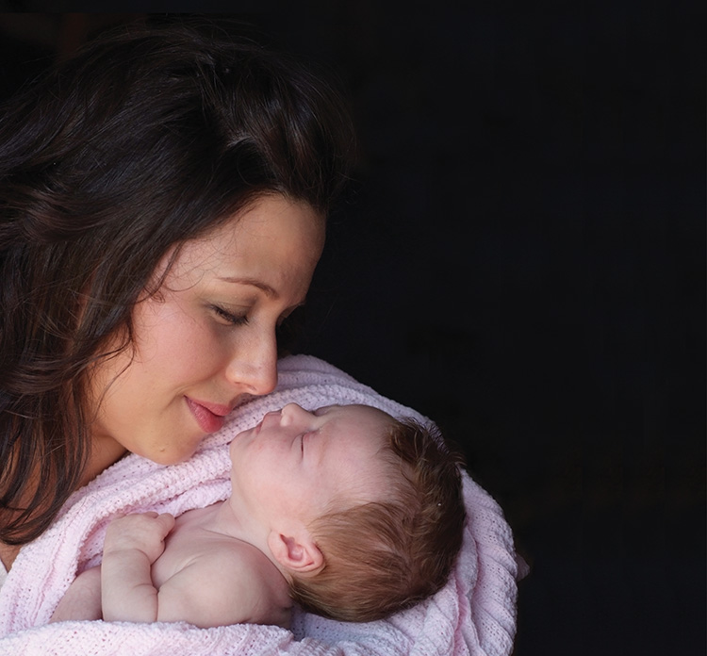
Your
Baby’s Care
at Birth

Slide 22
The Miracle of Birth
Your Baby’s Immediate Care
Once your baby is delivered, your healthcare provider will…
Wipe baby off with clean towel to keep him from getting cold.
Stimulate baby to cry.
Place baby skin to skin with mom.
Notes:
Suction may or may not be used.

Slide 23
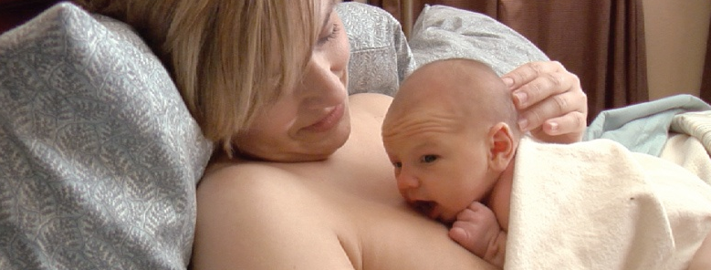
Skin-to-skin
Skin-to-skin contact is beneficial and therapeutic for both you and your baby. Even dads and partners can take part in this special bonding.
Skin-to-skin will be:
uninterrupted for at least the first hour, unless separation is medically indicated or first breastfeeding is complete.
encouraged throughout the rest of the hospital stay and beyond.
Vitals are taken during skin-to-skin, however no weights or measurements will be taken during this time.

Slide 24
Apgar Score
The Apgar Score is an assessment tool used for evaluating a newborn’s life outside the womb.
FIVE AREAS SCORED | 0 | 1 | 2
Heart Rate | Absent | Under 100 | Greater than 100
Color | Blue or pale | Body Pinking | Pink
Breathing | Absent | Not Regular | Crying/Good rate
Muscle Tone | Absent/Flaccid | Some movement | Active movement
Reflexes | No response to stimulation | Grimace | Sneeze or cough responds to stimulation

Slide 25
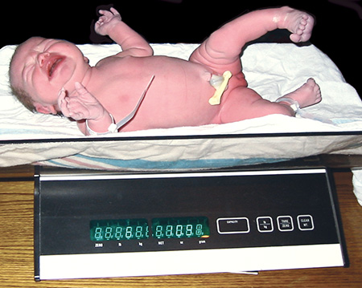
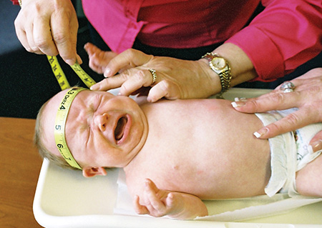
Physical Assessment
Birth Weight
Head Circumference
Notes:
A quick physical assessment of your baby will be done at the time of birth. Weight and measurements are done at one hour after skin-to-skin and first breastfeed. A more thourough exam will be done by the healthcare provide you have chosen for your infant at a later time. known as “vital statistics”.
A more thorough exam will be done by the healthcare provider you have chosen for your infant at a later date.

Slide 26
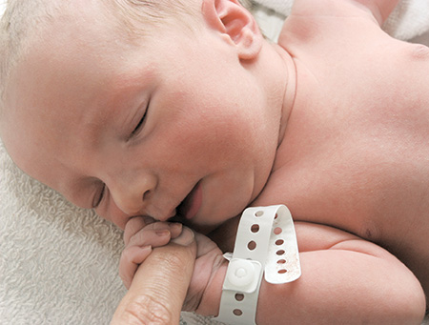
Identification
Notes:
After delivery, you and your baby will be given identification bracelets to wear. Baby will also have an electronic tag placed on his/her ankle. This is an added security feature that locks exit doors and alarms if tampered with or removed from the unit.

Slide 27
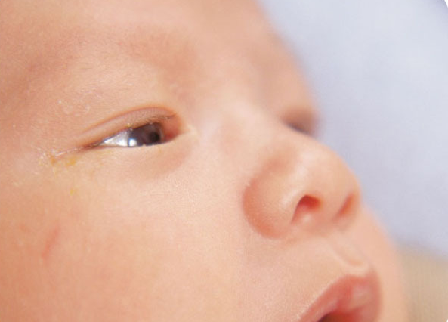
Eye Prophylaxis & Vitamin K
Notes:
Eye prophylaxis: Erthromycin Eye Ointment: A medicated ointment or drops will be applied to your baby’s eyes within 2 hours after birth to protect him from contracting bacterial infections during delivery.
Vitamin K: It is recommended all babies get Vitamin K after delivery because:
All infants, regardless of sex, race, or ethnic background, are at higher risk for Vitamin K Deficiency Bleeding until they start eating regular foods, usually at age 4-6 months, and until the normal intestinal bacteria start making Vitamin K. This is because:
At birth, babies have very little Vitamin K stored in their bodies because only small amounts pass to them through the placenta from their mothers. The good bacteria that produce Vitamin K are not yet present in the newborn’s intestines.
Breast milk contains low amounts of Vitamin K, so exclusive breastfed babies don’t get enough Vitamin K from breast milk alone.
From: http://www.cdc.gov/ncbddd/vitamink/facts.html

Slide 28
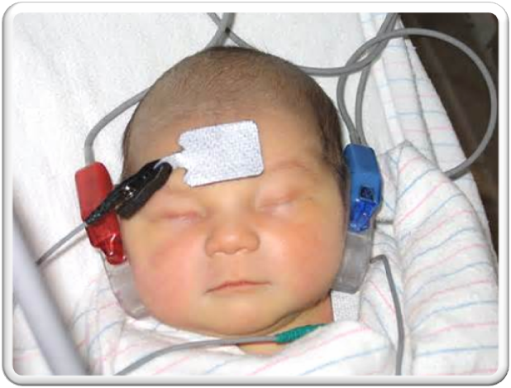
Newborn Screening
The Wisconsin Newborn Screening (NBS) Program screens infants for:
44 disorders
Hearing loss
critical congenital heart disease (CCHD)
Notes:
44 disorders (including hypothyroidism, cystic fibrosis, sickle-cell disease) via a blood test done typically between 24-48 hours of age. Blood is obtained through a prick on the heel. This may be done at breast to reduce discomfort for the baby.
Hearing loss: Via a hearing screen, as seen on the slide. It takes about 10 minutes or less and is done after 6 hours of age.
Critical Congenital Heart Disease: Done by measuring the baby’s oxygen level on hands and feet.

Slide 29
Circumcision and Care
Removal of the foreskin that covers the tip of the penis
Uncircumcised
Circumcised
Notes:
Discuss with healthcare provider. American Academy of Pediatrics does state that there are health benefits of circumcision, however there is not enough strong evidence to make a universal recommendation.

Slide 30
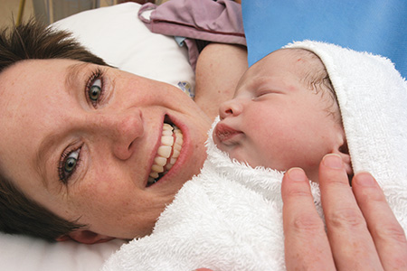
Rooming-in
A part of family centered maternity care consists of
“rooming-in” or “rooming-together”.
This is when the new mother and her partner keep the baby in the room with them at all times.

Slide 31
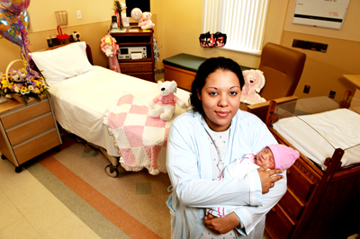
Why Rooming In?
Keep your baby with you on a 24-hour basis to:
Get breastfeeding established
Better learn feeding cues
Enhance bonding
Improve baby’s immunity
Build your confidence and skill
Notes:
31

Slide 32
Some safety tips for rooming together:
Call for help anytime.
Remember to NEVER leave your baby unattended or alone for any reason.
Pull the emergency cord or push the button if you feel a nurse is needed immediately.
When using the restroom, wheel the crib to the restroom door to see and hear your newborn.
Keep the baby close to your hospital bed – the furthest point away from the doorway.
Do not give your baby to anyone you do not know or who has not properly identified themselves.
Your hospital will have special security procedures in place are there to protect your baby.
Y
Please make sure you follow them!

Slide 33
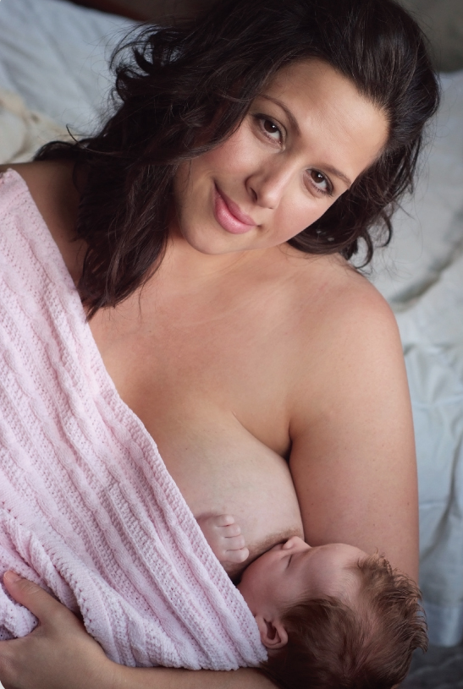
Feeding Your Newborn

Slide 34
Exclusive Breastfeeding
UNICEF and World Health Organization (WHO) recommend exclusive breastfeeding the first 6 months of a baby’s life.
This is based on scientific evidence.
Breastmilk provides all the nutrients that an infant needs during this time.
Exclusive breastfeeding may reduce common childhood illnesses such as diarrhea and pneumonia.

Slide 35
Breastfeeding
We believe that breastfeeding is the best and safest way to feed your baby if you are medically able to do so.
Regardless of the method you choose to feed your baby, we strive to allow you the time, privacy and support to achieve the goals you set for yourself and your new baby.
Notes:
Nurses will work with you to ensure comfort of your feeding plan.

Slide 36
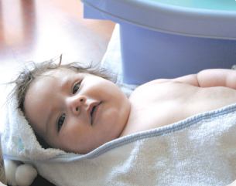
Bathing and Care
Bath time is a wonderful time for the baby to learn your touch. This is also a great time to assess your infant’s skin, rashes, healing of the umbilical area and the overall general appearance of your baby.
Notes:
Bath demonstration by instructor.
Baby Bath –
No bath until at least 6 hours old.
Baby must have 2 consecutive temps above 98.6 degrees; 2 hours apart
Temps are started right away and given every hour for first 4 hours.
Sometimes it takes a while (more than 24 hours) for baby to warm up
Baby will be given submersion bath in hospital
Reduces loss of body temperature
Cord is still moist while in hospital, so this practice will not hinder the drying process.
Once home, use sponge bath until umbilical stump falls off.

Slide 37
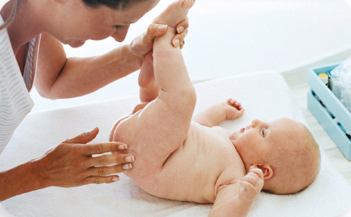
Taking Off a Soiled Diaper
If your baby is soiled, gently wipe off as much as you can.
Always wipe front to back.
When cleaning, make sure to get into all the folds and crevices.
If you have a boy, place a cloth or diaper over his
penis to keep from getting a surprise shower!
Notes:
Diaper, swaddle and holding demo. Parent participation encouraged.

Slide 38
Check diaper frequently and change as soon as it is soiled or wet.
Use warm water (never hot) to clean your baby’s bottom during diaper changes.
If the baby has a soiled diaper and you need to use more than warm water use very mild soap.
Make sure your baby’s diaper area is fully dry before applying another diaper.
Ask your healthcare provider what protective ointments may be used to protect your baby’s skin.
Tips On
Preventing and Treating
Diaper Rash

Slide 39
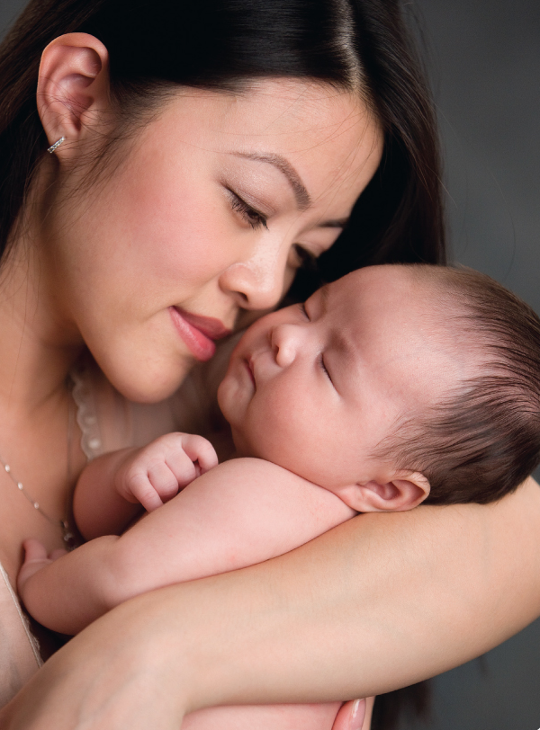
Your Baby’s
Communication

Slide 40
Newborn Senses
Your newborn enters this world with all senses functioning… sight, sound, touch, taste and smell.
Your insight to this little one starts from the moment you hold him in your arms.

Slide 41
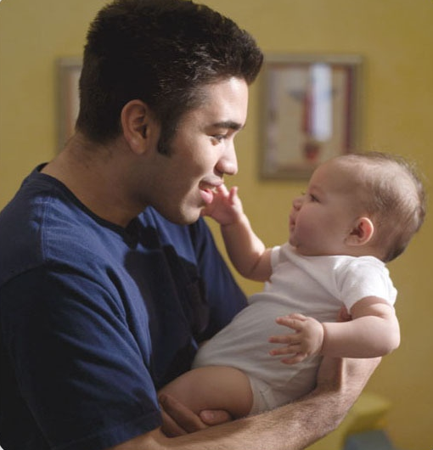
What Your Baby Sees
At birth, your baby can see 12-14 inches.
He can determine between light and dark.
He is aware of movement.

Slide 42
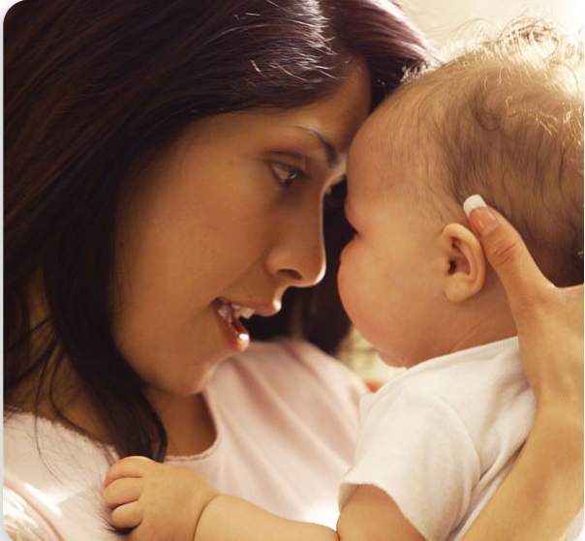
What Your Baby Hears
Your baby was listening to your heartbeat in the womb and quite often will recognize mother’s voice as well as dad’s voice at birth. Many babies will turn their head towards a voice, although eye contact may not be coordinated with listening quite yet. Just know that he is studying your voice.
It is amazing that this little one can be so observant!

Slide 43
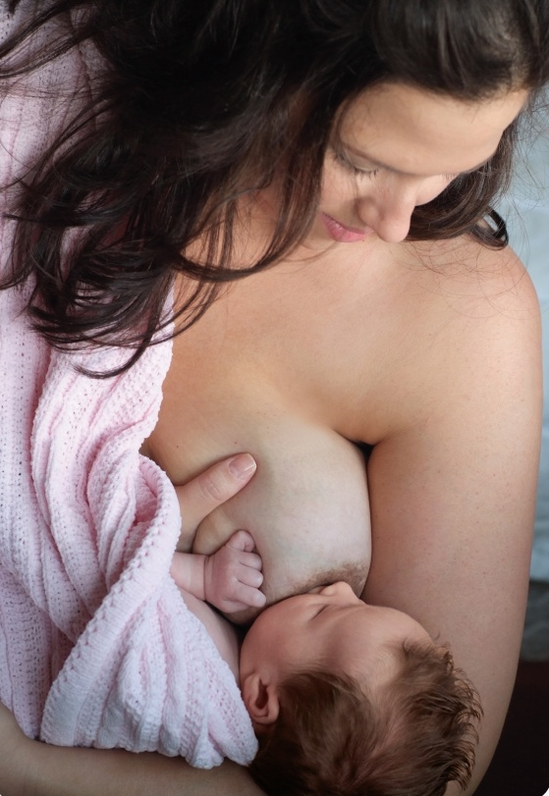
What Your Baby Tastes
Your baby’s taste buds are developing in the womb.
He prefers sweet tastes over bitter.
He will show a strong preference to breastmilk.
Make sure you put your baby to breast the first hour after delivery, or as soon as possible.

Slide 44
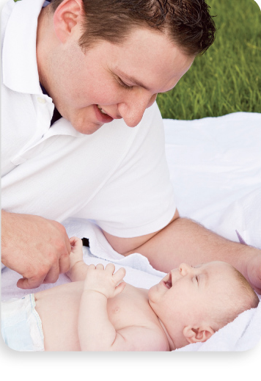
What Your Baby Smells
The brain’s olfactory (smell) center forms early in the womb, just as the sense of taste does. The two are closely intertwined. This is another reason it is important to get baby to breast as soon as possible.

Slide 45
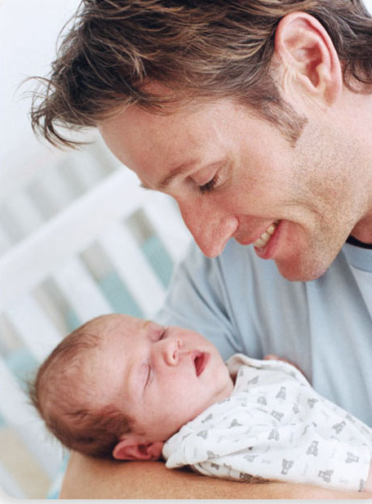
Touch
Touch is vital for brain development. Hold him, cuddle him, keep him warm and give him lots of kisses! You CANNOT spoil him!

Slide 46
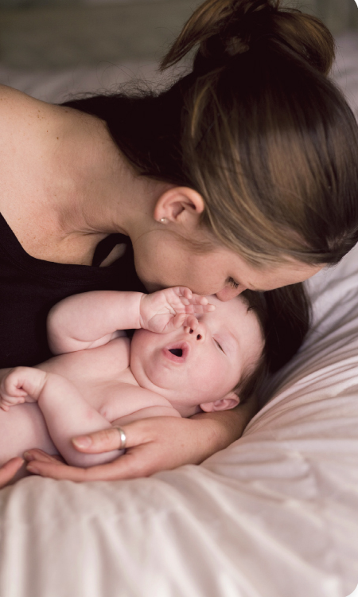
Infant Behavior
Sneezing
Hiccupping
Chin Trembling
Straining during bowel movement
Irregular breathing patterns
Noises during sleep
Fussy time

Slide 47
Sleep Patterns
Be aware of signs that will tell you that your baby is ready to sleep:
Yawning
Fussing
Rubbing eyes
Looking away
Lack of sleep may be one of the most difficult adjustments for new parents.

Slide 48
Crying plays an important role. Research has shown that a newborn may spend anywhere from 1-5 hours throughout the day crying.
What Your Baby’s Cry Means

Slide 49
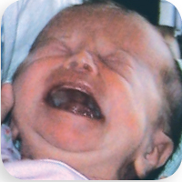
Causes of Crying
I am hungry!
I don’t feel well!
Change my diaper!
I need to be held!
I am too cold or too hot!
I am bored!
I’m tired!

Slide 50
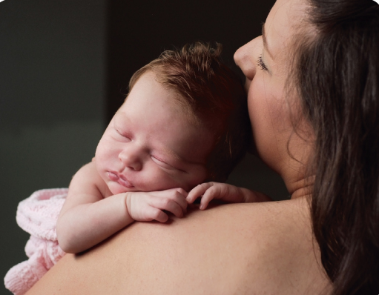
Soothing Your Baby
Swaddle
Side/Stomach Position
Shushing Sounds
Swing
Sucking
Notes:
Swaddle video for instructor review: http://hipdysplasia.org/developmental-dysplasia-of-the-hip/hip-healthy-swaddling/
If you can’t view the above video, here is one of the methods described in steps:
1. If using a square cloth, fold back one corner creating a straight edge.
2. Place the baby on the cloth so that the top of the fabric is at shoulder level.
3. If using a rectangular cloth, the baby’s shoulders will be placed at the top of the long side.
4. Bring the left arm down.
5. Wrap the cloth over the arm and chest.
6. Tuck under the right side of the baby.
7. Bring the right arm down and wrap the cloth over the baby’s arm and chest.
8. Tuck the cloth under the left side of the baby.
9. The weight of the baby will hold the cloth firmly in place.
10. Twist or fold the bottom end of the cloth and tuck behind the baby, ensuring that both legs are bent up and out.
It is important to leave room for the hips to move.
Show parents the 5 S’s…Football hold.

Slide 51
Techniques to Soothe a Crying Baby
Hold your baby and rock.
“Wear” your baby in a sling or other front carrier.
Swaddle your baby, making sure to use a large enough blanket.
Take a walk outside or a ride in the car.
Produce “white noise” by running a fan or vacuum.
Sing or hum to your baby.

Slide 52
Coping Skills for Parents with a Crying Baby
Take a personal “timeout”. It is OK to lay your baby in his or her crib and take a short break.
Take a breath and try to be calm before picking up your crying child.
Have family and friends available for help when you need it.
Sleep when your baby sleeps.
Ask for what you need…this does not mean you are a failure as a parent.

Slide 53
Colic
What is Colic?
Continuous crying for 3 or more hours a day.
Usually seems to start at 1-3 weeks of age.
The reason is truly unknown.
It is always important to consult your healthcare provider.

Slide 54
REMEMBER… no matter how tired, angry or beside yourself you feel, NEVER SHAKE or toss YOUR BABY into the air. Any of these can cause brain damage, blindness or even worse, death. Always protect your baby’s head from any jerking movements.

Slide 55
Baby’s
Warning Signs & Reportable Symptoms

Slide 56
Baby’s Warning Signs & Reportable Symptoms
Call your healthcare professional if any of the following symptoms of illness occur…
Very pale, blue or yellow lips or skin color
Problems breathing or consistent cough
Seizures
Continual refusal to eat or significant decrease in number or feedings
Less than 4 wet diapers a day first week or less than 6 a day after week 1
Bowel movements that contain blood or frequent diarrhea
Redness around the belly button extending out into the stomach, drainage, or foul odor
Does not urinate within 6-8 hours of circumcision.

Slide 57
Baby’s Warning Signs & Reportable Symptoms
Call your healthcare professional if any of the following symptoms of illness occur (continued)
Fever of 100.4 degree temperature or more
Increased irritability or excessive crying without a cause
Extreme sleepiness or floppy arms and legs
Rash, especially if it covers a large part of the body
Repeated vomiting or green vomit
Drainage from one or both eyes when the white is pink or bloodshot

Slide 58
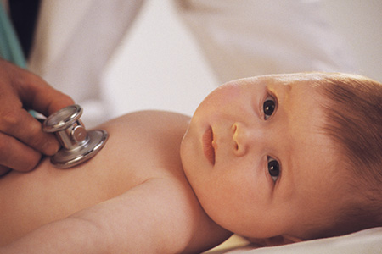
Regular Office Visits
Are Important!

Slide 59
Baby Weight each Visit
The average newborn weighs approximately 7½ pounds at birth.
Infants typically lose 5 to 8% of their birth weight in the first few days of life before they start to gain.
Most regain their birth weight by day 10.
Double it by the sixth month.
Triple it by 1 year.

Slide 60
Immunizations
The CDC recommends all infants receive the Hepatitis B Vaccine series with the first dose being administered at birth.
Please discuss this, and all other vaccinations, with your baby’s healthcare provider.
Y

Slide 61
Safety Measures
Home
Car Seat
Bed

Slide 62
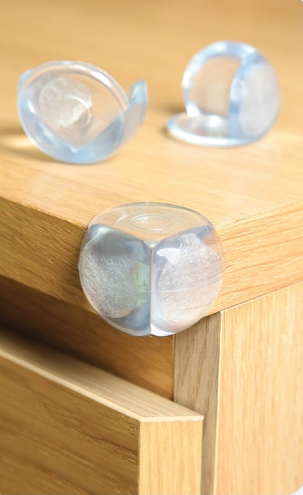
A Personal Home Safety Checklist
You should have at least 2 working smoke detectors.
Have a working fire extinguisher.
Have cover plates for electrical outlets.
Secure all cabinet doors with latches.
Place screen or safety rails on fireplaces. Use guards on 2nd story windows.
Do not allow any small objects in or around baby’s sleeping or play area.
Keep buckets of water up and toilet seats down.
Keep all medications up and away.
Use cordless window coverings.
Be aware of toxic houseplants.
Notes:
It only takes 1” of water for a child to drown.

Slide 63
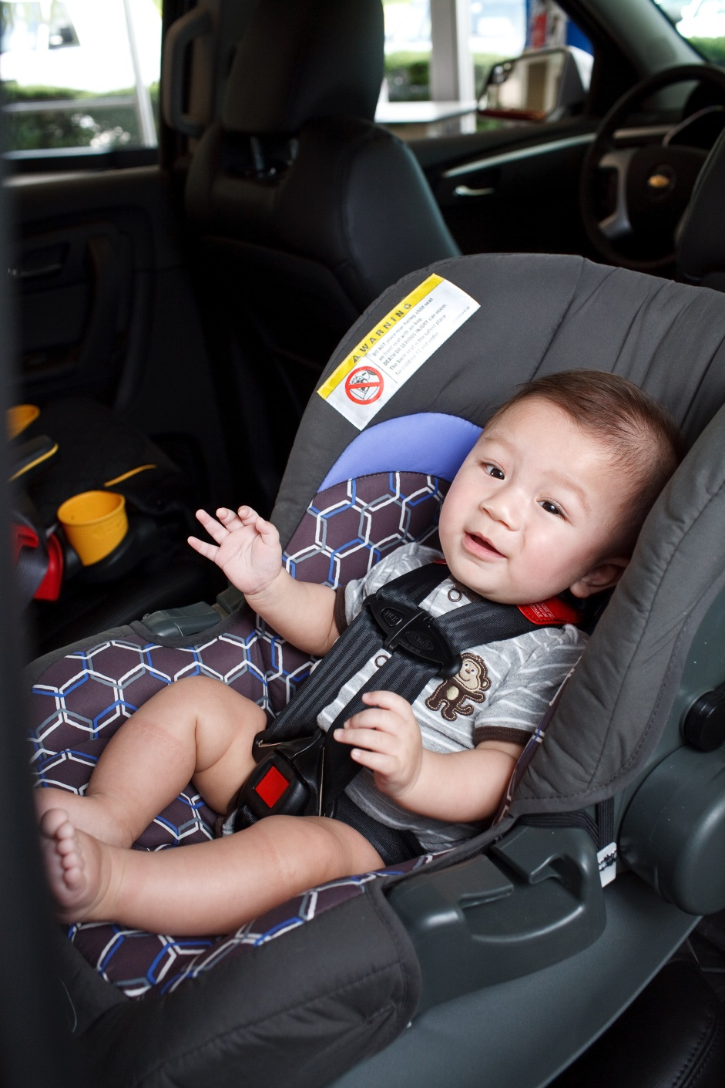
Car Seat Guidelines

Slide 64
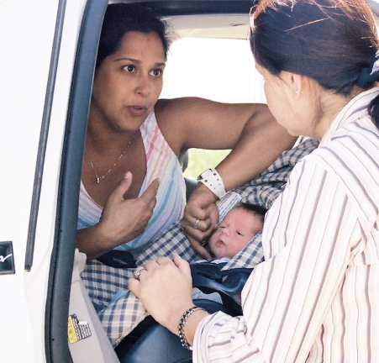
Keeping Your Baby Safe in the Car
The safest place is in the middle of the back seat (depending on the car).
Tips for Purchasing a Car Seat:
Never buy used
Bucket vs. Convertible
Tips for Installation:
Seats should have less than 1” of movement when installed properly.
Rear facing until baby meets car seat’s rear-facing maximum weight and height
Always consult your car seat owner’s manual
Get it checked…before you deliver
Additional Car Seat Safety Tips:
Car seats do expire
Secure loose items in the car including cell phones, coffee mugs, tissue boxes, etc.
Notes:
The American Academy of Pediatrics (AAP) recommends that children should ride in rear-facing child safety seats as long as possible. New research indicates toddlers are more than 5 times safer, according to the AAP, riding rear-facing in a convertible car safety seat until they reach the maximum height and weight recommendation for that particular model.
An infant in a rear-facing seat should not be used in front of an active airbag.
It is a good idea to practice installing and adjusting the car seat before the birth of your baby. If you have trouble at first, you have time to practice and get the proper help that you need.

Slide 65
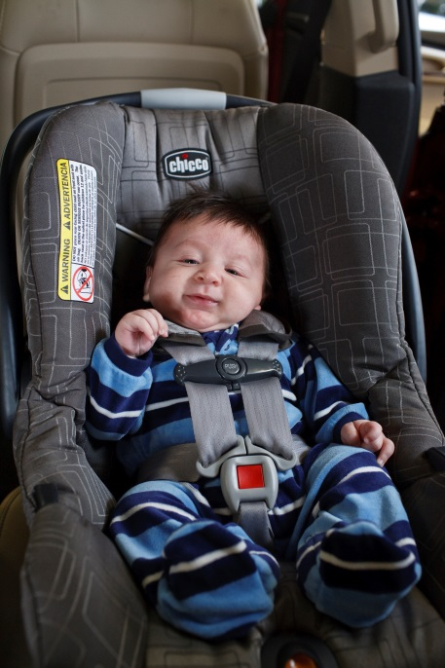
Car Seat Help
Video
Center for Childhood Safety
842 S. Military Ave., Green Bay, WI 54304
www.ccsgb.org | 920-272-0110

Slide 66
More Car Seat Help
Sheboygan County Health and Human Services
Sue Schmidt - Child Passenger Safety Technician
920-459-3258 or 920-946-2286

Slide 67
Keeping Your Baby Safe in the Car
Tips for Securing Infant
No snowsuits or bulky clothing
No “sleeping bag” style car seat covers – over the top only.
Use only what comes with your car seat – do not add head rests
Use of items that did not come with your car seat may void the warranty.
Straps should be snug with clasp across the breastbone (pinch test)
Notes:
The American Academy of Pediatrics (AAP) recommends that children should ride in rear-facing child safety seats as long as possible. New research indicates toddlers are more than 5 times safer, according to the AAP, riding rear-facing in a convertible car safety seat until they reach the maximum height and weight recommendation for that particular model, or at least to the age of 2.
An infant in a rear-facing seat should not be used in front of an active airbag.
It is a good idea to practice installing and adjusting the car seat before the birth of your baby. If you have trouble at first, you have time to practice and get the proper help that you need. Center for Childhood Safety is a great resource!
Pinch test: you should not be able to double up the webbing when pinching above the breastbone buckle.

Slide 68
SIDS and Safe Sleeping Environment
SIDS is the sudden death of an infant under the age of one, which remains unexplained.
To reduce the risk of SIDS, place your healthy infant on his back to sleep.
Studies show that there is a decrease in SIDS deaths due to parents understanding this important information.
Back to Sleep campaign sponsors include:
National Institute of Child Health and Human Development
Maternal and Child Health Bureau
American Academy of Pediatrics
SIDS Alliance
First Candle Association of SIDS and Infant Mortality Programs

Slide 69
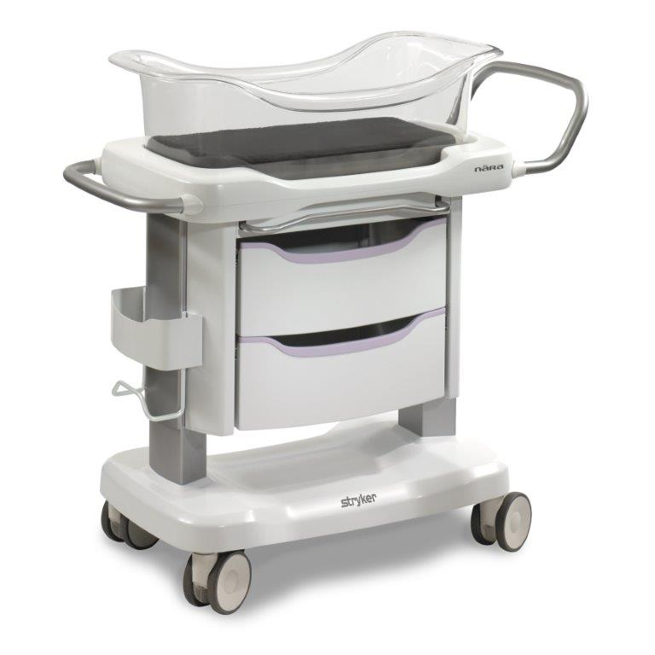
Safe sleep begins with moms
in the hospital
After delivery, the drop in mom’s hormone levels can result in sleepiness.
If you find yourself feeling sleepy,
try these tips:
Sit upright
Sip water
Turn lights on
Dress lightly or uncover so you stay cool
Your baby must be placed in its crib if you are dozing or sleeping.
Ask your support person or nurse for help!

Slide 70
Additional tips to reduce the risk of SIDS…
Place your baby on his back to sleep every time.
Place your baby on a firm mattress in safety-approved crib.
Car seats, bouncers, or rock n’plays are not safe sleep surfaces
Keep your baby’s head and face uncovered during sleep.
Remove bedding from sleep area.
No toys or stuffed animals
No sleep positioners
Eliminate exposure to any smoke before or after birth of baby
Keep your baby’s sleep area close to, but separate from, where you and others sleep.
No co-sleeping
Only one baby per crib
Consider using a pacifier at sleep time. If breastfeeding, introduce after first month.
Notes:
Share all of these important tips with babysitters, grandparents and other caregivers. Snuggly blankets/fluffy toys can be used during supervised bedtime routines (rocking to sleep), but should not be put in crib with baby.

Slide 71
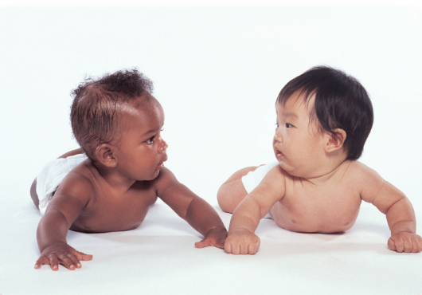
Tummy Time
Tummy time helps with…
Strength
Hand use
Balance
Eye-hand coordination
The ability to roll over (belly to back is the first way most babies roll over)
Helps to prevent flat spots on the back of the head
Make sure that tummy time with your infant is a time when he is awake. He must be supervised!
Notes:
Tummy time begins as early as skin-to-skin time in the hospital.

Slide 72
Realistic Expectations
Trust yourself!
You will instinctively learn about your baby as your baby will learn about you. Stop to enjoy this…
Journey through Parenthood!

Slide 73
Remember…
Have Realistic Expectations for Yourself and Your Baby.
This is a time of transition!

Slide 74
Consider Attending These Additional
Class Offerings…
Complete or Express Childbirth Education
Breastfeeding
Infant CPR
Sibling Class
Grandparent Class
Hospital Tour
To register
visit
www.onefamilyevents.org

Slide 75
Conclusion
Parenting is a process that requires you to constantly learn. You will discover new skills and insights along the way. Please know that you will make mistakes and stumble from time to time. You are only human, but trust your instincts!
At the end of the day, it comes down to love. Your love for this precious life will guide you in making the right decisions.
Take pleasure in parenthood and ENJOY YOUR JOURNEY!

