Slide 1
HSHS Crisis Prevention & Intervention
Notes:
1

Slide 2
Course objectives
HSHS Colleagues will learn:
Workplace Violence
Different types of workplace violence and examples
HSHS Workplace Violence Policy
Principles of Crisis Prevention
Keys to Communication - HEAL
Crisis Intervention: Verbal and Non-Verbal Approaches
Report Disruptive Behavior in Peminic/Verge
D-09 Event Reporting and Analysis Policy
Notes:
2

Slide 3
frequently used acronyms
CDC – Center for Disease Control
ENA – Emergency Nurses Association
HEAL – Hear, Empathize, Acknowledge and Lead
NIOSH – National Institute for Occupational Safety and Health
OSHA – Occupational Safety and Health Association
Notes:
3

Slide 4
Purpose
Inspire and embody Christ’s healing love through education and training to promote zero-harm and strive for zero serious safety events at all HSHS facilities.
Foundation for the HSHS Safety Program
Safety Event is a situation where best or expected practice does not occur. If this is followed by serious harm to a patient, then we call it a Serious Safety Event

Slide 5
Workplace Violence
"...violent acts (including physical assaults and threats of assaults/verbal abuse) directed toward persons at work or on duty.” (CDC/NIOSH, 2002)
Notes:
Interaction time: Ask group members if they feel safe at work?
5

Slide 6
Violence Types
Service User
(Patient, Family Member & Visitor)
Criminal
Worker on
Worker
Personal Relationships
(Domestic)
Service User violence most common, followed by Worker on Worker (CDC & OSHA, 2015). Most frequent location of violence includes Emergency rooms, Geriatric units, Psychiatric units, Waiting rooms and large crowded areas (ENA, 2015)
Notes:
Per CDC (2015), customer/client type violence most common followed by worker on worker. OSHA describes as well.
Most frequent areas of violence include ER, geriatric units, psychiatric units, waiting rooms, large urban areas (ENA,2015)
6

Slide 7
Criminal violence
The subject has no relationship with the organization or the victim
Normally their aim is to access:
Cash
Stock
Drugs
Or perform some other criminal act
Notes:
7

Slide 8
Worker on Worker Violence
Commonly known as lateral or horizontal violence
Examples:
Bullying
Frequently verbal and emotional abuse that is unfair or offensive
Often directed at those being viewed as “lower on the food chain”
Supervisor to Supervisee
Doctor to nurse
Notes:
8

Slide 9
Personal relationship/Domestic Violence
A relationship to an employee outside of work that spills over to the work environment.
Individuals who have a relationship with an employee, examples include:
Spouse
Significant others
Acquaintances
(CDC,NIOSH, 2015)
Notes:
9

Slide 10
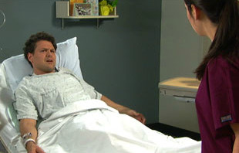
Service User Violence
Most common type of violence in health care settings
Frustration
Feel nothing is in their control
Poor diagnostic outcome
Customer/Client includes:
Patient
Family member
Visitor
(CDC, NIOSH, 2015)
Notes:
It is important to realize that, although some psychiatric diagnoses are associated with violent behavior, most people who are violent are not mentally ill, and most people who are mentally ill are not violent. Substance abuse is a major contributor to violence in populations both with and without psychiatric diagnoses (Friedman, 2006).
10

Slide 11
Important
Although some psychiatric diagnoses are associated with violent behavior, most people who are violent are not mentally ill, and most people who are mentally ill are not violent. Substance abuse is a major contributor to violence in populations both with and without psychiatric diagnoses (Friedman, 2006).
Notes:
11

Slide 12
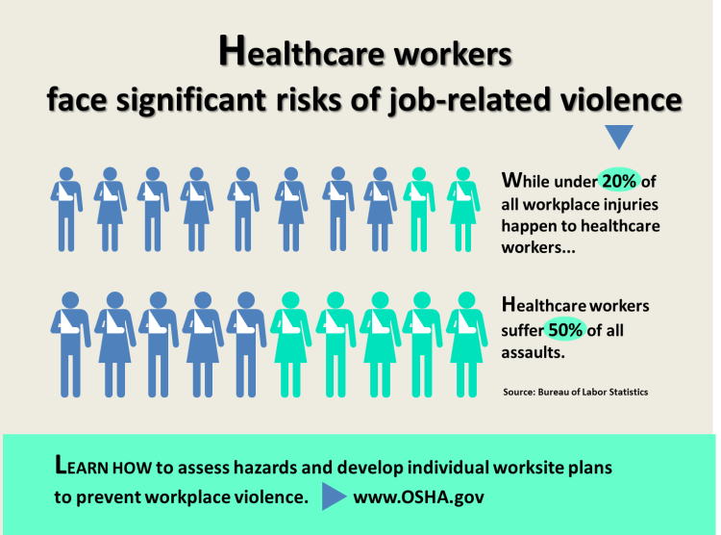
risks
Notes:
Interactive slide
12

Slide 13
risks
When patients enter the health care setting they are under stress and don’t feel well. For family members, there is a lot of waiting and anger starts to arise because they may feel they are not getting “the best” care. Be attuned to these patients, family members and wait times.
Clinical
Notes:
When patients enter the hospital setting they are under stress, they don’t feel well, family members, there is a lot of waiting and anger starts to arise because they sometimes feel they are not getting “the best” care. Be attuned to these patients and wait times.
13

Slide 14
risks
Clinical Patient Risk Factors Include:
Under the influence
Pain
Violent history
Cognitive impairment
Angry about clinical relationships
Mental illness
Financial pressure
Clinical
Notes:
14

Slide 15
risks
Environmental Risk Factors Include:
Noise
Transporting patients
Long waits for service
Overcrowded, uncomfortable waiting rooms
Working alone
Understaffed
Access to firearms
Unrestricted movement of the public
Environment
Notes:
15

Slide 16
HSHS/Local System Policies
#1: Workplace Violence
HSHS Policy
“HSHS does not tolerate violence, physical violence, threats, or acts of intimidation against any person. All colleagues have a duty to promptly and accurately report these events to their leader or People Services.”
ck to add text
Notes:
Insert link to policy or demonstrate how to view on intranet. Have copies in folder/packet giving to class. ???Searching patient belonging-do we have a policy for that?
16

Slide 17
HSHS/Local System Policies
#2: HSHS D-09 Event Reporting and Analysis Policy a
“Colleagues are required to report any actual or potential unsafe condition, situation or occurrence that is unexpected and not part of the normal course of care or any adverse outcome that is not directly related to the natural course of the patient's illness or underlying condition present upon admission.”
“Details of the Event are, by the end of the Event Reporter's (colleague(s) involved) current shift or as soon as possible thereafter, promptly and accurately recorded by the Event Reporter in a single, standardized, integrated information system designated by HSHS. Currently, the Peminic Event Reporting System will be used to report Event occurrences.”
Emergency/ Urgent Care Related
“Events related to Care coordination/ communication including Access to care issues (delay in treatment, transfer, or bed availability); inadequate communication with other providers; provider not available; referral/ consult problem.
Discharge AMA, left without being seen or before visit complete.
Refusal of important medications, treatments.”
Security/ Manpower/ Other
“Disruptive Behavior: Report any abusive patient, Sexual Assault or attempted sexual assault, abduction of patient, patient missing, or assault that has the potential to impact patient safety.”
“HIPAA violation, privacy issues or reports of property destruction.”
Notes:
Insert link to policy or demonstrate how to view on intranet. Have copies in folder/packet giving to class. ???Searching patient belonging-do we have a policy for that?
17

Slide 18
Principles of Crisis prevention
Notes:
18

Slide 19
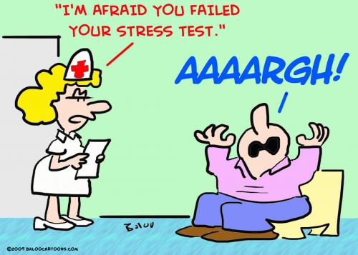
Check Your Surroundings
Note exits and emergency phone numbers if you change work areas.
Confusion, background noises, and crowding can increase stress levels.
Meal times, shift changes, and while transporting patients are all times of increased disruptive behaviors.
“Other risks such as the weather, patient load and morbidities, noise levels, and staffing levels are unchangeable and often unpredictable. Be alert to changes in your environment” ( CDC/NIOSH, 2015).
(CDC, 2015)
Notes:
“Other risks such as the weather, patient load and morbidities, noise levels, and staffing levels are unchangeable and often unpredictable. Be alert to changes in your environment” ( CDC,NIOSH 2015).
19

Slide 20
Dress Safely
According to the CDC and NIOSH, “Dress for safety by removing anything that can be used as a weapon or grabbed by someone.”
•Long hair should be tucked away so that it can't be grabbed;
•Jewelry - avoid earrings or necklaces which can be pulled;
•Overly tight clothing can restrict movement;
•Overly loose clothing, or scarves can be caught;
•Glasses, keys, or name tags dangling from cord or chains can be hazardous; make sure to use breakaway safety cords or lanyards.”
(CDC, NIOSH 2015)
Notes:
According to the CDC, NIOSH (2015), “Dress for safety by removing anything from your person that can be used as a weapon or grabbed by someone.
•long hair should be tucked away so that it can't be grabbed;
•jewelry - avoid earrings or necklaces which can be pulled;
•overly tight clothing can restrict movement;
•overly loose clothing, or scarves can be caught;
•glasses, keys, or name tags dangling from cord or chains can be hazardous; make sure to use breakaway safety cords or lanyards.”
20

Slide 21
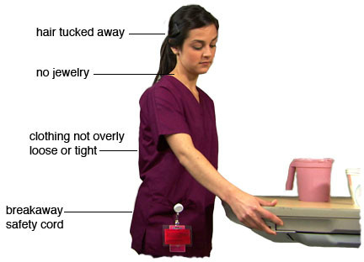
Dress Safely
(CDC, 2015)
Notes:
21

Slide 22
Keys to communication
Body Language
Tone of Voice
Word We Use
Notes:
22

Slide 23
7%
38%
55%
Notes:
23

Slide 24
Body language
Don’t
Do
Finger point, it may seem accusing or threatening
Shoulder shrug, it may seem uncaring or unknowing
Use slow and deliberate movements, quick actions may surprise or scare the other person
Notes:
You may be trying to de-escalate the situation when talking with an individual, but your body language may be saying something else. Remember the patient will react to what you are saying with your body language
24

Slide 25
TONE of voice
It’s HOW you say WHAT you say.
When the words and the tone are in conflict, people believe the TONE.
It is difficult (nearly impossible) for people to hear their own tone
Notes:
25

Slide 26
Words we use
Instead of… | …Say
“What are you here for?” | “How can I help you?”
“Sorry ‘bout that.” | “Please accept my apologies.”
“You can’t go back right now.” | “Let me check and see when you can see your family member.”
“I don’t know.” | “I’ll be happy to do that for you” or “I’ll find out for you.”
“If you can be patient, I’ll be with you as soon as I can.” | “It appears you are in a hurry. I will do my best to wrap this up so I can assist you.”
“I don’t understand what you are asking/want.” | “I want to make sure I understand. Let me see if I have this right…”
“Hold on” | “May I place you on hold?”
“We are short-staffed and can’t go any faster.” | “I apologize you have had to wait. Is there anything you need right now?”
(Indiana University Health, 2011)

Slide 27
Keys to Effective Communication
HEAL
Hear the customer
Empathize with the person
Acknowledge how they feel
Lead toward a resolution
Improves perception of care or service received
Anxiety reduction
Loyalty
Consistent delivery
(Rubin, 2014)
(Wall, 2011)

Slide 28
HEAL = Consistency
Hear: Hear the customer. Allow them to vent, truly listen. Many times angry people just want someone to listen them. To hear their story.
Empathize: Angry people want to beard, to be listened to and to have their upset and emotional state recognized. Put yourself in their situation.
Acknowledge: Agitated people want you to acknowledge that the situation is causing them some form of hardship. If you do not acknowledge how the event made them feel, they are likely to become more angry and abusive.
Lead toward a resolution: Take responsibility for this step. Use action phrases that state what you can do, not what you cannot do.
(Rubin, 2014)
Notes:
Discuss consistency examples, know hospital protocols and procedures, if you don’t know, find out. (Allowing visitors to get water behind nurses station)

Slide 29
IF Crisis prevention techniques do not work , then here are suggestions to handle crisis escalation
Notes:
29

Slide 30
CRISIS
Intervention Techniques
A situation— real or perceived —that significantly reduces a person’s ability to cope.
Notes:
30

Slide 31
The Crisis cycle
Normal State
There is no Crisis Yet
Stimulation
Something happens to cause the person to become excited, upset, physically uncomfortable
Escalation
The person shows obvious signs of distress, including observable physical changes in behavior
Notes:
Note the warning signs, acknowledge the patient’s/visitor’s concern, maybe they have been complaining about this one nurse in ER or not getting their food on time. Acknowledge this with the individual and help them move on.
Warning signs: Change in posture
Stands taller, sets shoulders
Moves away/moves closer
Points
Forms a fist may load the arms
Escalation
The person shows obvious signs of distress, including observable physical changes and changes in behavior.

Slide 32
As it escalates
If the situation escalates…
Recognize Warning Signs
Decisions
Should I be doing this?
Can I do this?
Involve a Colleague / Supervisor / Security
Crisis Intervention Techniques
Call for Security or dial 911
Notes:
The next slides on approach deal with the first stages of the crisis cycle: stimulation to escalation
32

Slide 33
important
Recognize Warning Signs
Change in posture
Stands taller, sets shoulders
Moves away/moves closer
Points
Forms a fist and may strike
Mumbling and pacing
Staring and eye contact
Tone and volume of voice
Anxiety
Acknowledge the patient’s/visitor’s concern,
Maybe they have been complaining about one nurse in ER or not getting food on time. Acknowledge this with the individual and help them move on.
Notes:
33

Slide 34
Staring and eye contact
Tone and volume of voice
Anxiety
Mumbling
Pacing
(Luck et al, 2007)
Notes:
*Lauretta Luck, Debra Jackson & Kim Usher, "STAMP: components of observablebehaviour that indicate potential for patient violence in emergency departments,"Journal of Advanced Nursing (2007), Volume 59, Issue 1, pages 11-­‐19.

Slide 35
WARNING SIGNS
Not everyone exhibiting warning signs will become violent.
However, no warning sign should be completely ignored. Any one or combination of warning signs, at any level, may indicate a potentially violent situation.
(Luck et al, 2007)
Notes:
35

Slide 36
Crisis Intervention Techniques
DO NOT GIVE UP THE THINGS THAT CAN HELP YOU MOST.
Ask yourself:
Should I be doing this:
Alone?
Here?
Now?
At all?
Can I do this:
Safely?
Notes:
The next slides on approach deal with the first stages of the crisis cycle: stimulation to escalation

Slide 37
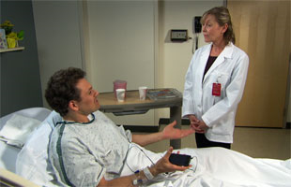
Approach: Verbal
Allow the person to express concern. (Hear)
•“It seems as if something is bothering you, would you
be willing to share your concerns?”
Be empathic (Empathize)
•"I understand how frustrating this must be for you.”
Apologize if appropriate. (Acknowledge)
•"I'm sorry this happened.” “Let's find a way to fix it."
Use a shared problem solving approach. (Lead toward a resolution)
•“Do you have suggestions of how to correct the problem?”
Be alert to early signs of a patient's rising anxiety; perhaps offer an empathic inquiry such as, "You seem to be upset...can you tell me what's troubling you?"
(CDC, NIOSH, 2015)
Notes:
Be alert to early signs of a patient's rising anxiety; perhaps offer an empathic inquiry such as, "You seem to be upset...can you tell me what's troubling you?"

Slide 38
Approach: non-verbal
Be calm, or at least act calm. Maintain non-threatening eye contact, smile, and keep hands open and visible.
Listen. Nod your head to demonstrate that you are paying attention.
Respect personal space. Maintain arm/leg distance away from the individual. Avoid touching the upset individual as it may be misinterpreted.
(CDC, NIOSH, 2015)
Notes:
38

Slide 39
Set Limits in a non-threatening Manner
Guidelines
Examples
Paraphrase their words.
Verbalize their actions.
State what you can do.
“I hear you say you are angry because no one has been in to see you”
“ It appears you are angry, because you are swearing at me, which is not appropriate.” “How can we change this feeling of anger?”
“Here is what I can do for you…”
(CDC, NIOSH, 2015)
Notes:
Do not confuse setting limits with issuing threats which can signal to the patient that the situation is more hopeless than they had perceived, and may precipitate a violent response. Also, avoid arguing, as that may precipitate a violent resolution of crisis (CDC, NIOSH, 2015)
39

Slide 40
Avoid
Touching unless you ask first or it is essential for safety
Intervening too quickly or trying too hard to control the interaction by interrupting or talking over the person
Saying “you must”
Power struggles
Being condescending
Letting the individual get between you and the door
Being within the individual’s reach
Maintaining continuous eye contact
Notes:
40

Slide 41
Communication tips
Crisis escalating situations are emotional – control yours, it effects everything either positively or negatively
It does not matter what your position is – handling the situation is now your job. You are the professional – take it professionally
Understand - remove any triggers
Notes:
41

Slide 42
Communication tips
HEAL
Hear the customer – truly listen, allow them to vent
Empathize – no one is right or wrong
Acknowledge/Apologize – acknowledge the situation – wish it had not happened
Lead toward a resolution – state what you can do
When it moves beyond challenging
Should I be doing this: Alone, Here, Now, At All?
Involve a colleague/supervisor/security
Crisis Intervention Techniques
Paraphrase their words
“I hear you say you are angry because no one has been in to see you”
Verbalize their actions
“It appears you are angry because you are swearing at me, which is not appropriate.” “How can we change this feeling of anger?”
State what you can do
“Here is what I can do for you….”
Notes:
42

Slide 43
Lets see this
https://youtu.be/vTYllU-Eu2g
Notes:
43

Slide 44
Still Not getting anywhere?
Notes:
44

Slide 45
Take action…stay safe
Your words may not have the desired effect simply because there are too many complicating factors affecting the subject.
GET HELP!
When words do not work to prevent a crisis, it is time to act, which means now is the time to call Colleagues / Security / 911.
Remember the acronym
DONE. It identifies the four
conditions in which you are
DONE talking, and it is time
to act.
Danger
Overriding concern
No progress
Escape
Notes:
Danger: whenever you or someone else is imminent danger of being assaulted, or hurt, it is time to ack.
Overriding concern: Whenever you think that a matter of higher priority requires your immediate attention or your presence, it is time to act.
No Progress: Whenever you feel you have exhausted all of your verbal options and the patient is still not complying, it is time to act.
Escape: Arises out of need to remove self or others from an area due to signs of violence
At later stages along the Crisis Continuum a person may begin showing signs of loss of self-control and problem-solving ability. Verbal and non-verbal interventions can still be effective but additional techniques and precautions should be taken. Your focus now turns to protecting yourself and those around you.
Don't go it alone, enlist the help of Security or colleagues. Be prepared to use your panic device and to physically remove yourself if necessary. Position yourself to exit easily. Remove other patients or visitors from the room. If the person continues to escalate, follow your organization's procedure for immediate response to violent behavior. (CDC, NIOSH, 2015)
45

Slide 46
DONE – Time to get help
Danger: whenever you or someone else is imminent danger of being assaulted, or hurt, it is time to ack.
Overriding Concern: Whenever you think that a matter of higher priority requires your immediate attention or your presence, it is time to act.
No Progress: Whenever you feel you have exhausted all of your verbal options and the patient is still not complying, it is time to act.
Escape: Arises out of need to remove self or others from an area due to signs of violence.
Notes:
46

Slide 47
Debrief With team
The team should address the following questions during a workplace violent situation debrief:
Was the communication clear?
Were the roles and responsibilities understood?
Was situation maintained?
Was workload distribution equitable?
Was task assistance requested or offered?
Were errors made or avoided?
Were resources available?
What went well?
What should improve?
(CDC, NIOSH, 2015)
Notes:
47

Slide 48
Documentation
Peminic/Verge- REPORT, REPORT, REPORT
Report ALL disruptive behavior you experience at work, not just events that result in injury or harm, in Peminic/Verge reporting system.
Notes:
Interaction time: before moving to next slide ask group members: Have you ever failed to report a violent incident and why?
48

Slide 49
Course summary
HSHS Colleagues Learned:
Workplace violence definition
Service user is most common type of workplace violence
Principles of Crisis Prevention
Keys to Communication– HEAL
Hear the customer, Empathize, put yourself in their situation, Acknowledge how the event makes an individual feel, and Lead toward a resolution
Crisis Intervention: Verbal and Non-Verbal Approaches
Verbal: Hear: Please tell me what’s bothering you? Empathize: “I understand how frustrating this must be for you.” Acknowledge: “I’m sorry this happened. Let’s find a way to fix it.” Lead: “How can we correct this problem?”
Non-Verbal: Be calm or at least act calm. Maintain non-threatening eye contact, smile, and keep hands open and visible, Nod your head to demonstrate you are paying attention and listening, Respect personal space. Maintain arm/leg distance away from individual. Avoid touching the upset individual as it may be misinterpreted.
Report Disruptive Behavior in Peminic/Verge
Notes:
49

Slide 50
Optional Learning
CDC "Workplace Violence Prevention for Nurses"
Provides 2.6 contact hours for Continuing Nurse Education (CNE)
Must complete quiz to receive CNE contact hours
Notes:
50

Slide 51
Complete test & Evaluation on healthstream
Must score 80% or higher on test to pass the course
Notes:
51

